Slide 1


Circularity is the Future
The Future belongs to India

Slide 2

About me
2002 -> BE Electronics, Mumbai University
2004 -> MS, University of California Irvine
2004 – 2007 -> Firmware Engineer, Western Digital, Lake Forest, CA
2007 – 2008 -> Consultant, PwC, India
2008 – 2012 -> Deccan Aviation
2012 >>>

Slide 3
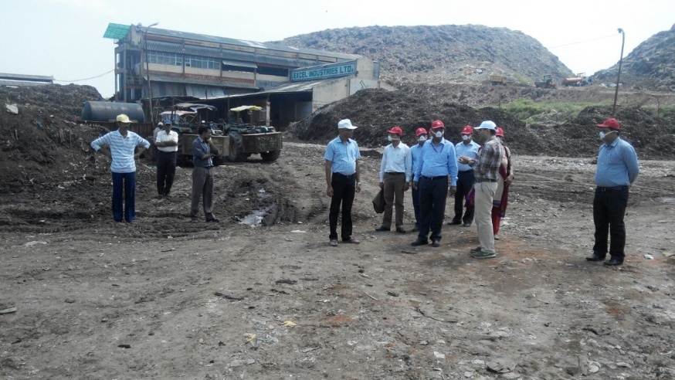
Your works seems so impactful
Are you working for an NGO?
Is there money to be made?
Isn’t it all mafia?
The struggle is real!

Slide 4
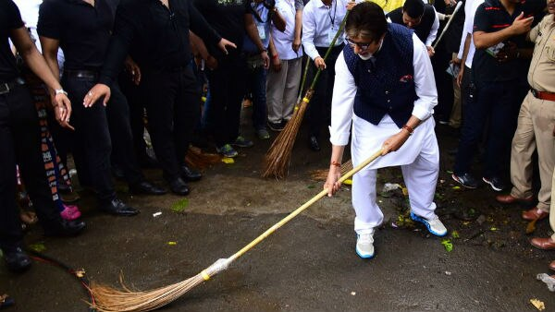
The whole country picked up the broom
Government on Regulations Steroids
Extended Producer Responsibility
Plastic Waste
E-waste
Waste Batteries
Tyres
Used Oil

Slide 5




Germany Population – 70 Million
EPR Industry Size – EUR 10 Billion
India Population – 1.4 Billion
EPR Industry Size - ???

Slide 6
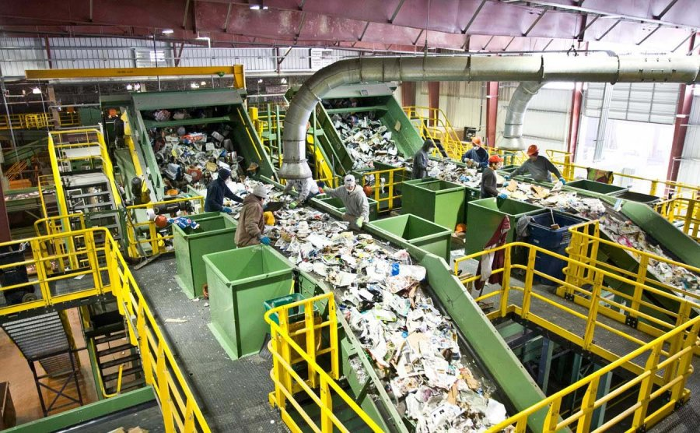
OPPORTUNITIES
Collection
Segregation
New Business Models
Recycling
Composting
Energy
Compliance & Advisory
Digital Technology

Slide 7
info@landbell-gfs.in

